Slide 1


Threshold-Based Segmentation of Brain MRI
Studying Theoretical Foundations and Practical Behavior of Threshold-Based Segmentation Methods in Medical Imaging
Ilaria Coccollone, Andrea Matteo Re
Politechnika Krakowska
Advanced Computer Image Processing

Slide 2
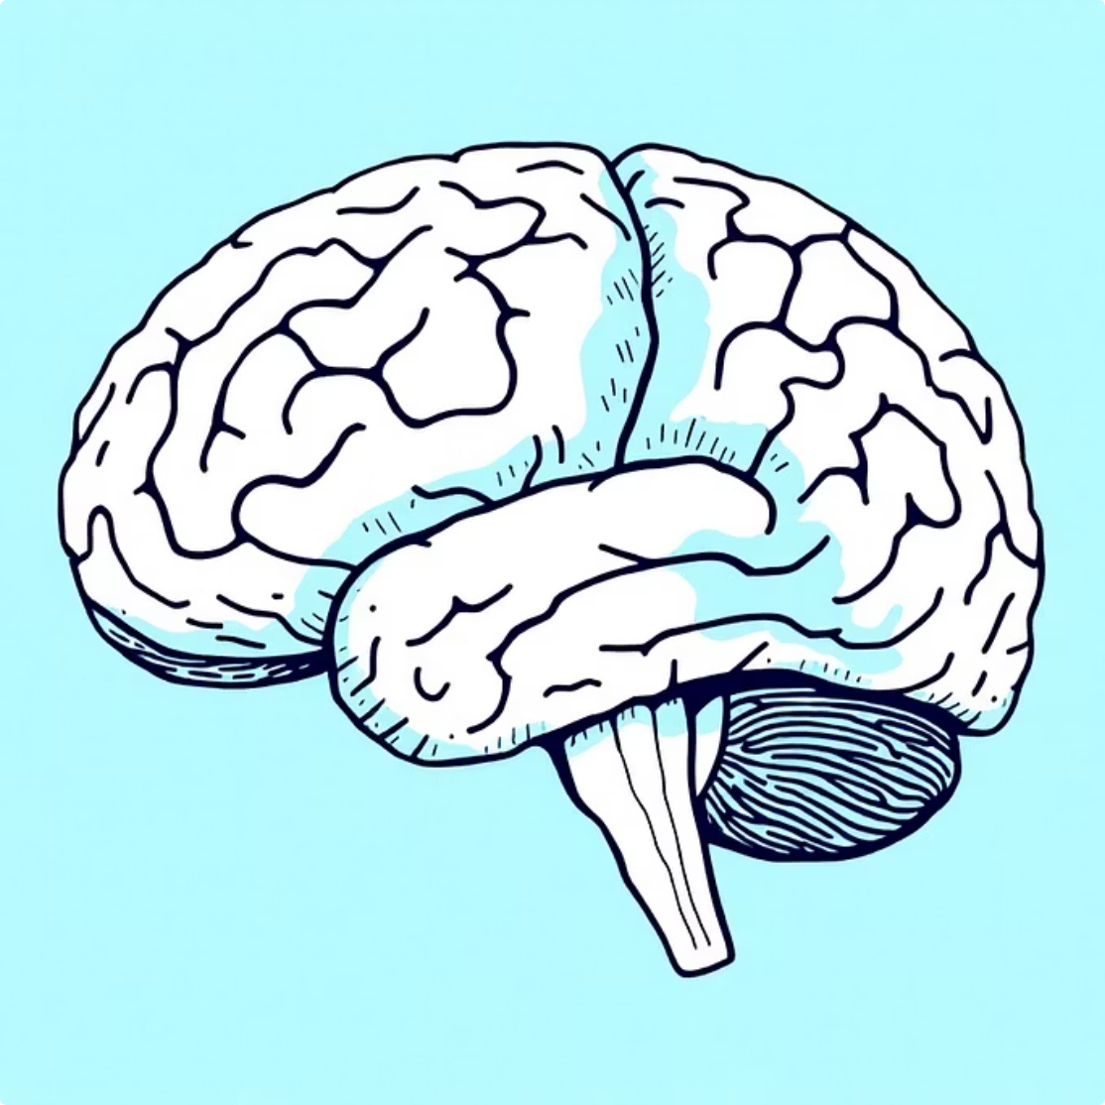


Why Brain MRI Segmentation?
Anatomical Visualisation
Disease Analysis
Challenges
Enables clear Visualization of Brain Structures by Separating Tissues based on Intensity Differences in T1-weighted MRI data.
Supports Preliminary Identification of Abnormal Regions by highlighting Intensity Variations associated with Pathological Tissue Changes.
Sensitivity to Noise, Intensity Inhomogeneity, and Preprocessing Choices, which may Reduce accuracy and Limit Reliable Tissue Differentiation.

Slide 3







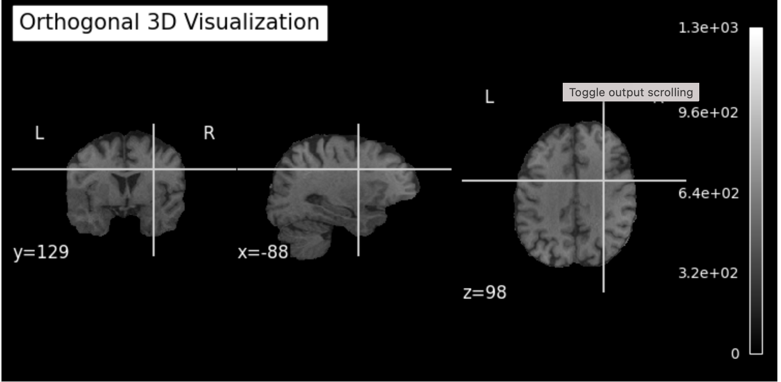

Dataset & Methodology Overview
Data Loading
Preprocessing
Histogram Analysis
Segmentation
Post-processing
Dataset Characteristics
T1-weighted brain MRI Acquisition
NIfTI (.nii) Medical Imaging Format
3D Grayscale Volumetric Data
Slice-based (2D)

Slide 4
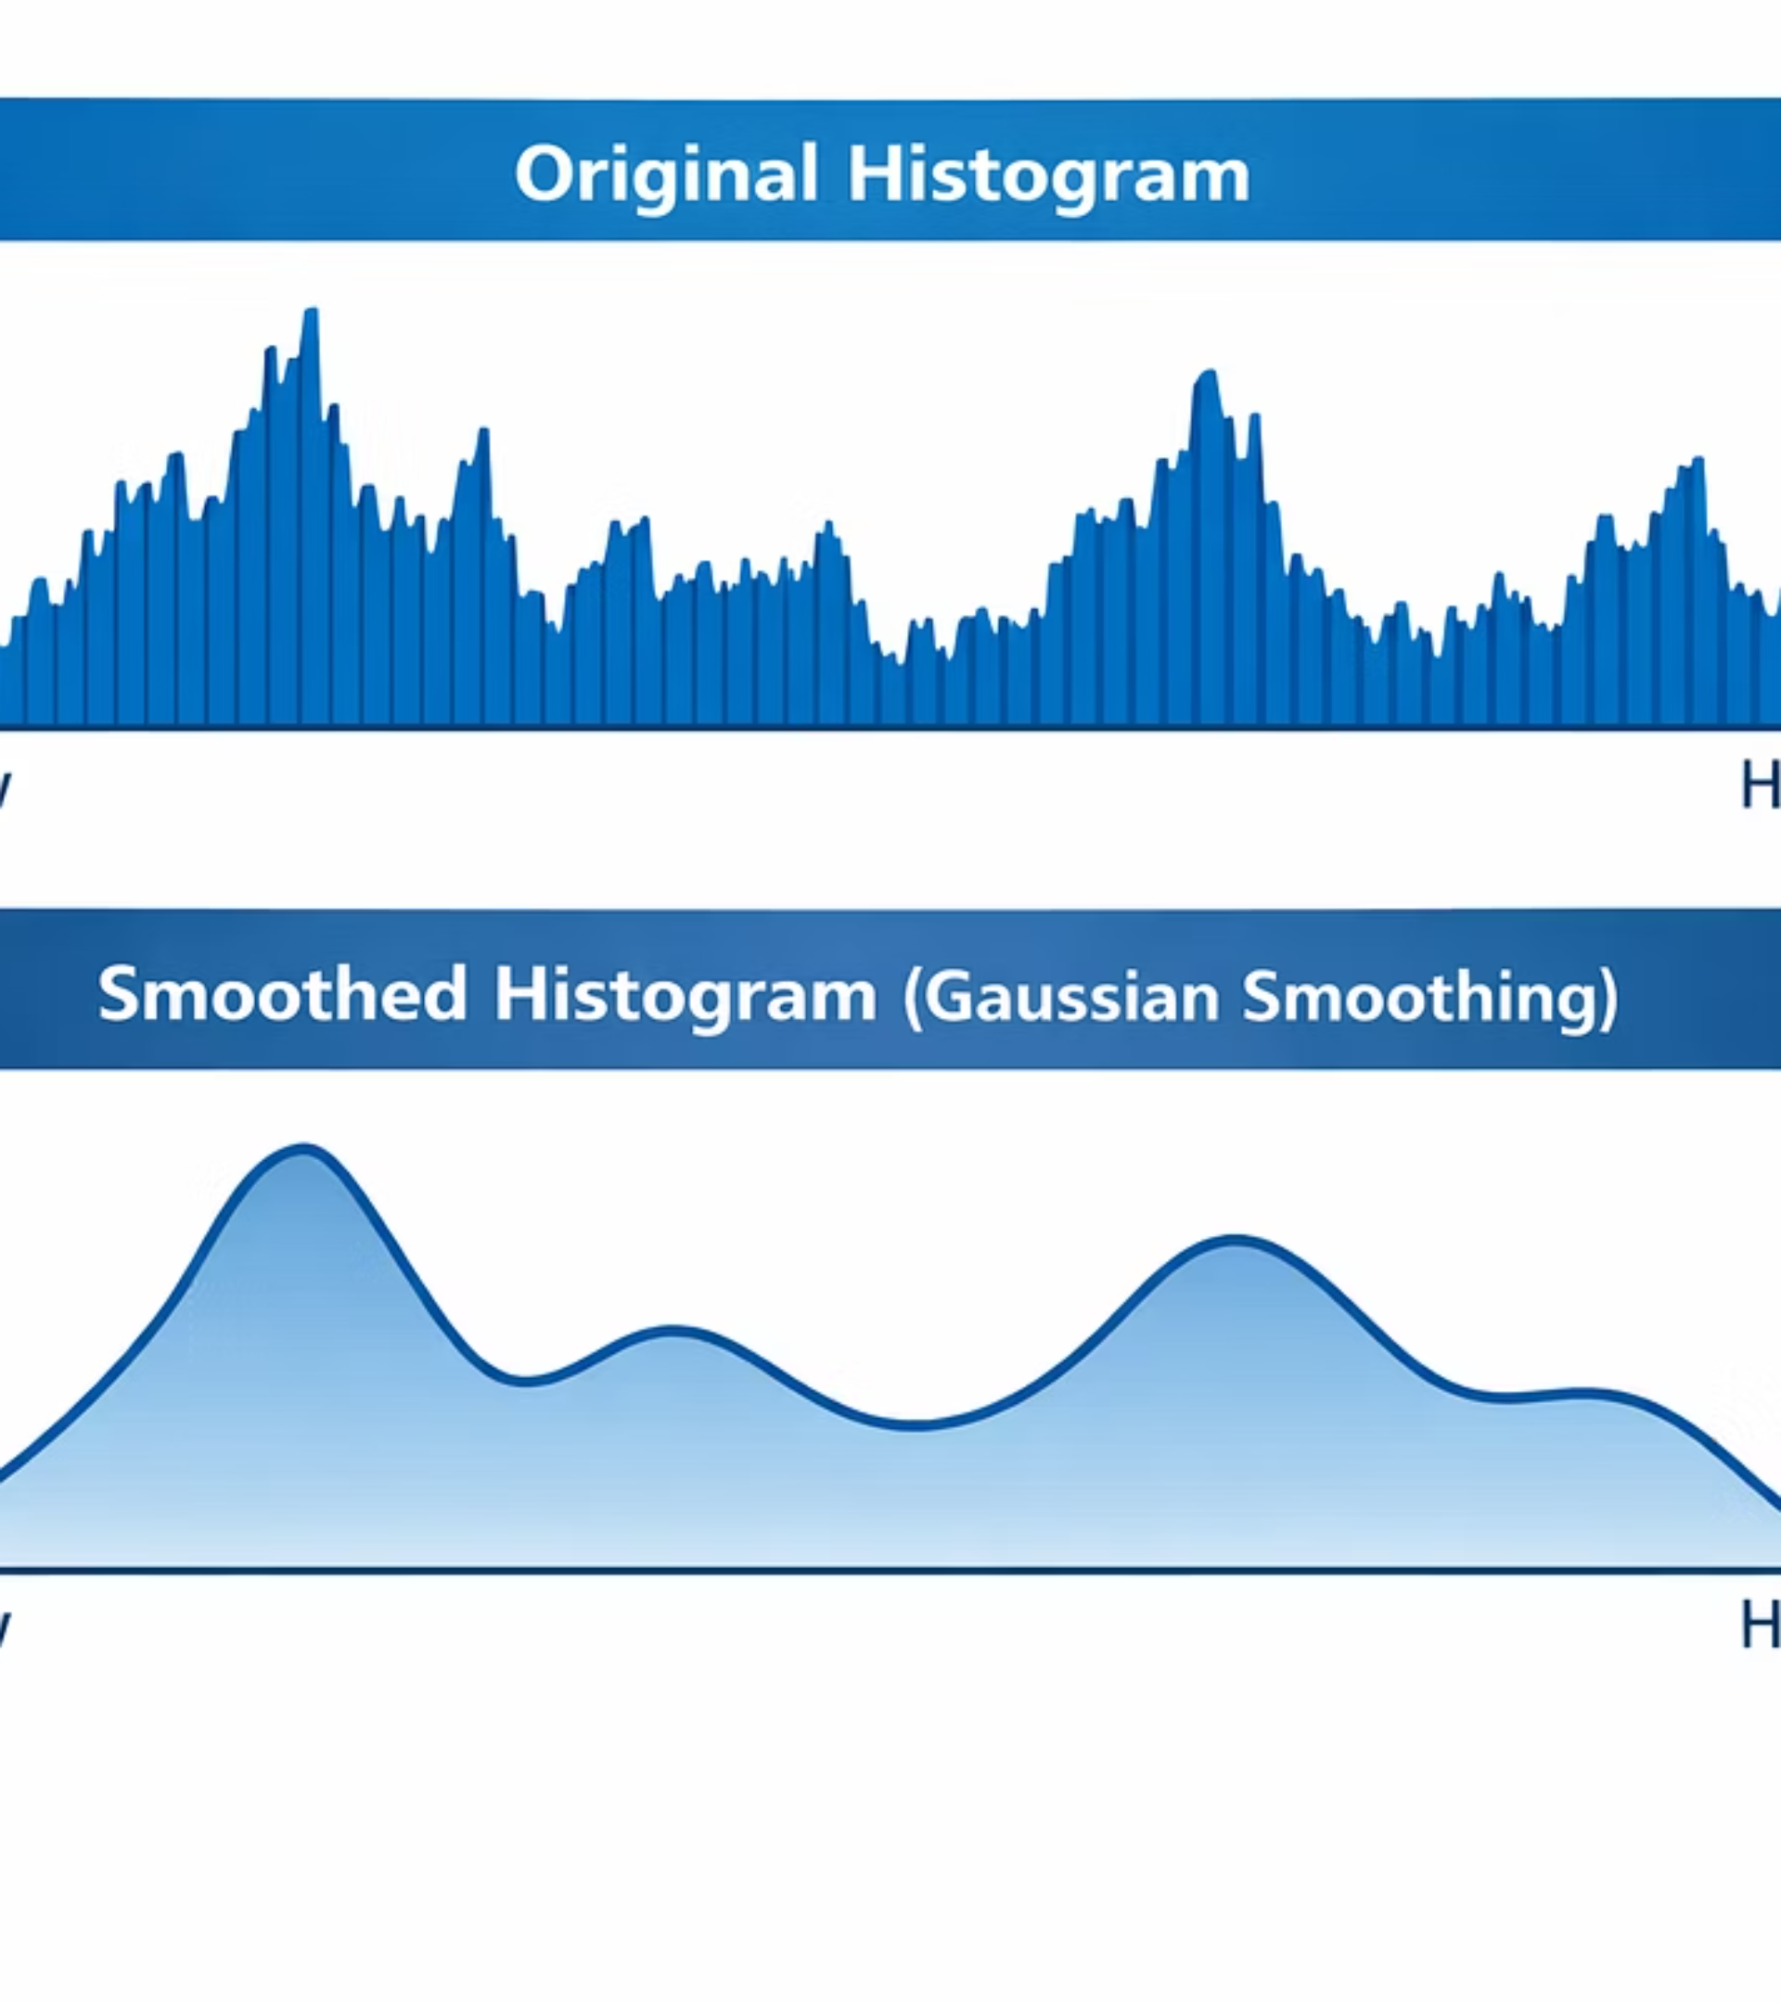

Preprocessing Steps
Data Loading & Visualisation
Using nibabel for NIfTI. Orthogonal views (axial, sagittal, coronal) for inspection.
Intensity Normalisation
Min-max scaling to [0,1] range. Improves numerical stability.
Gaussian Smoothing
Suppresses high-frequency noise. Preserves overall structure.

Slide 5
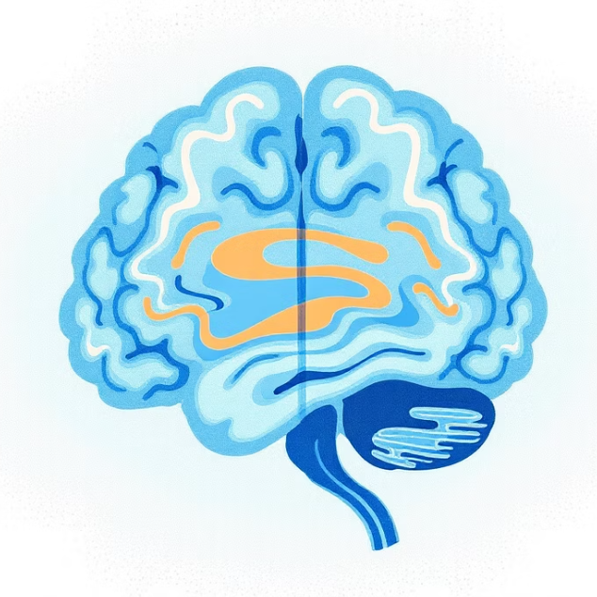
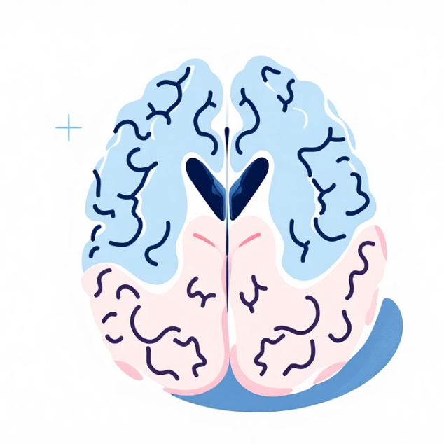

Thresholding Techniques
Global Otsu
Multi-Level Otsu
Adaptive Thresholding
Segments into 2 classes. Useful to distinguish Background from Foreground
Segments into >2 classes. Useful for CSF, Grey matter, White matter.
Local Thresholds for each Neighbourhood. Effective for Bias Fields.

Slide 6
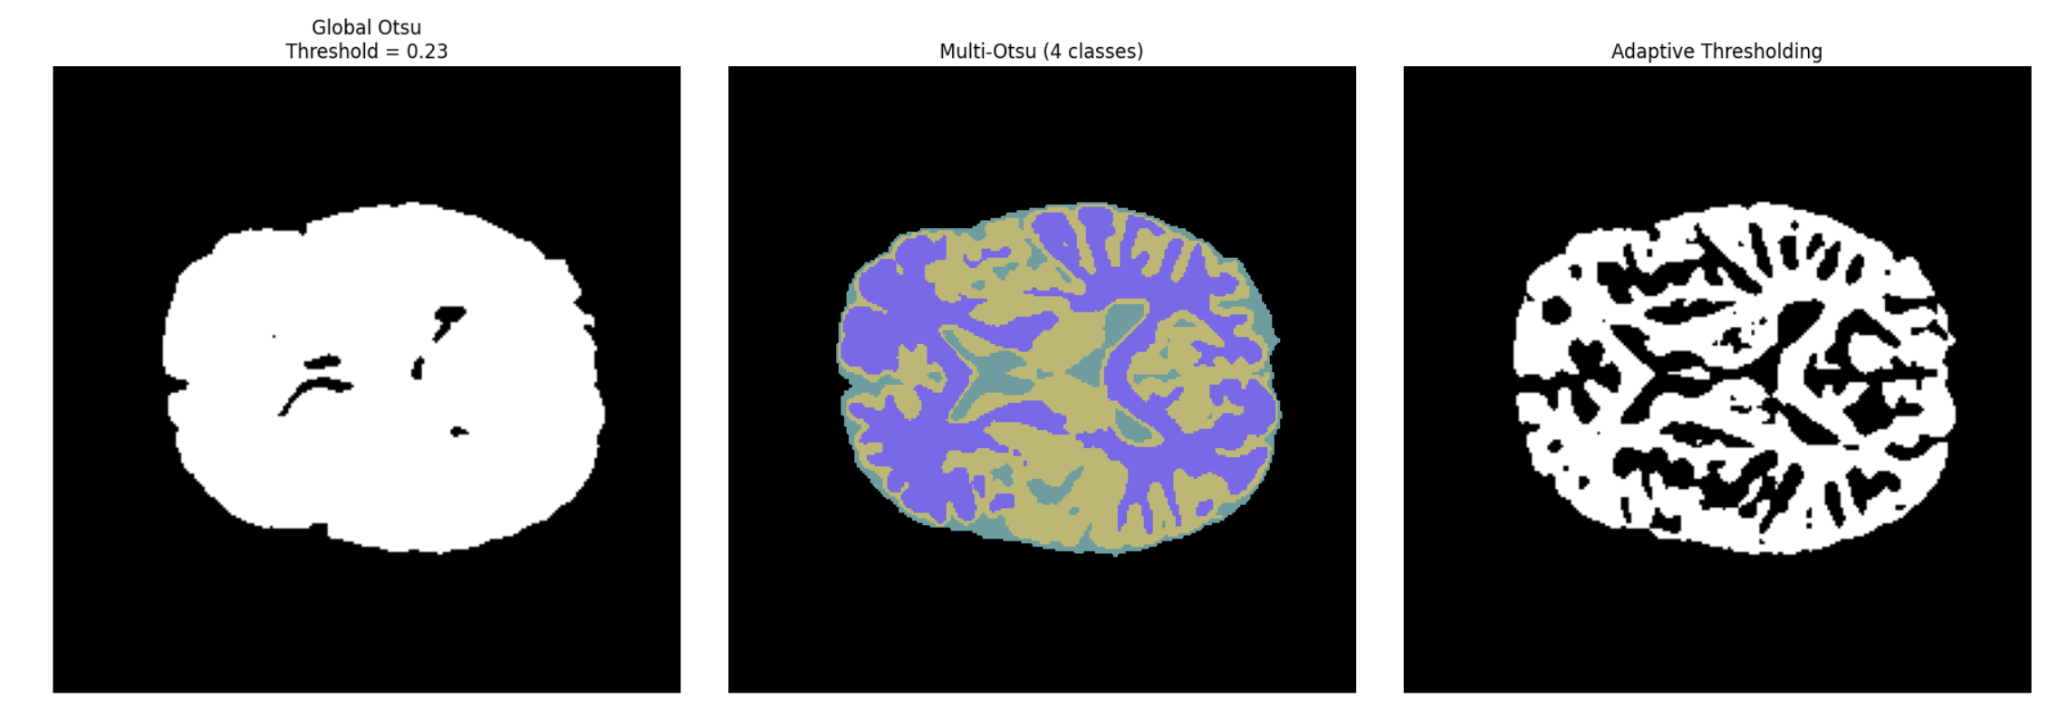
Thresholding Techniques Comparison
Global Thresholding (Otsu)
Automatic, unsupervised global thresholding
Separates foreground and background using intensity variance
Fast but sensitive to intensity inhomogeneities
Multi-Level Thresholding (Multi-Otsu)
Extension of Otsu to multiple intensity classes
Coarse tissue separation (CSF, GM, WM)
Intensity-based, no Spatial information
Adaptive (Local) Thresholding
Local, neighborhood-based thresholding
Robust to intensity non-uniformities
Higher computational cost

Slide 7
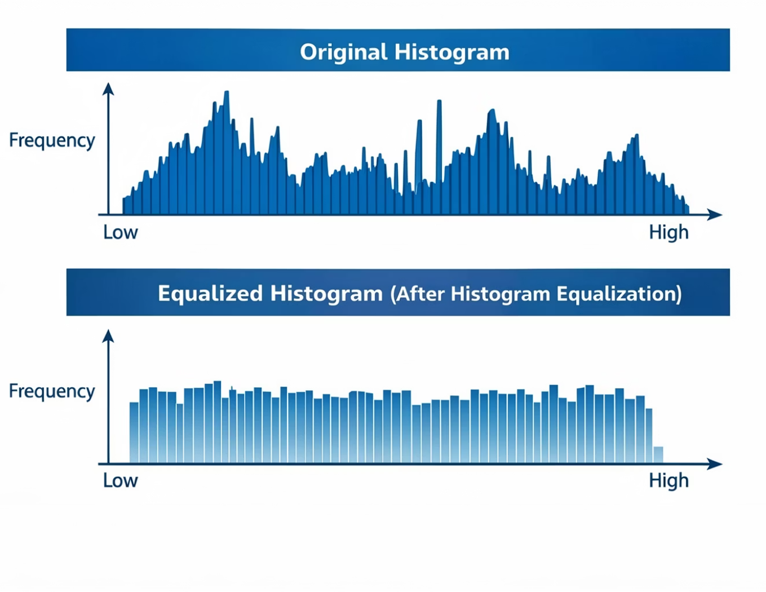


Histogram Equalization
Redistributes Intensities
Achieves uniform histogram distribution and enhances global contrast.
Amplifies Ranges
Amplifies underrepresented intensity ranges, making anatomical structures more distinguishable.
Improves Segmentation
Improves threshold-based segmentation performance.

Slide 8
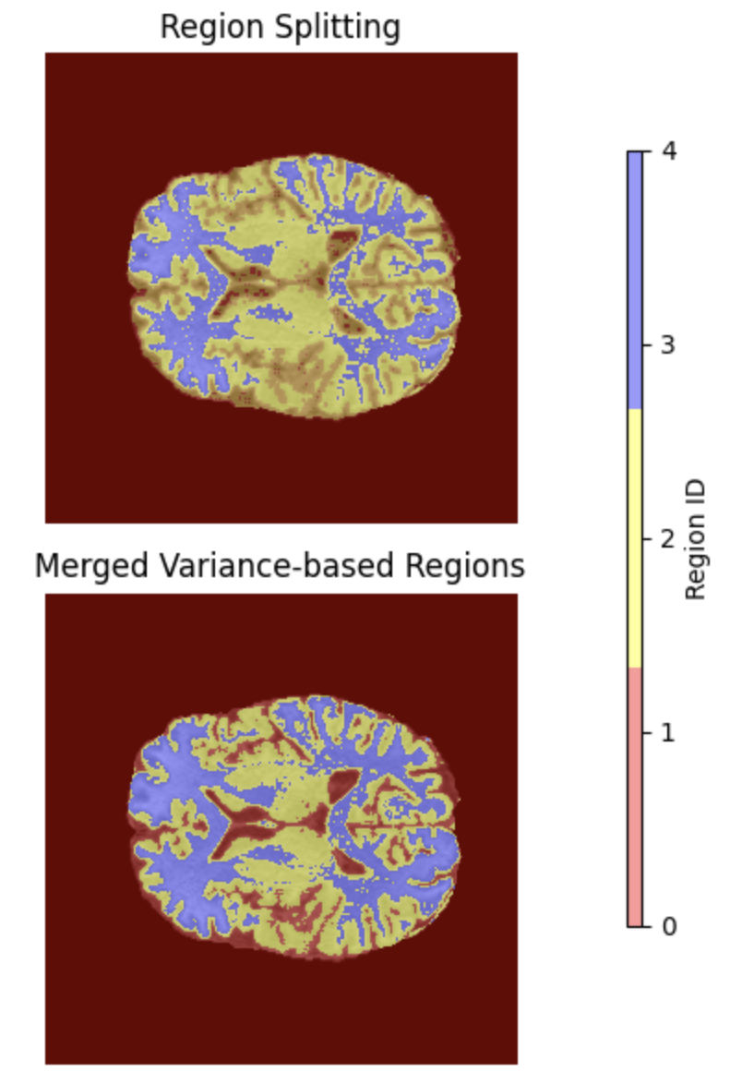


Region Splitting and Merging
Region Splitting
Divides the image into multiple distinct regions by applying predefined intensity thresholds, helping to isolate areas with varying characteristics.
Region Merging
Combines adjacent regions that exhibit similar properties, such as intensity or texture, to form larger, more coherent segments.
Benefits
Provides a more structured and robust segmentation, effectively reducing over-segmentation and improving boundary delineation.

Slide 9
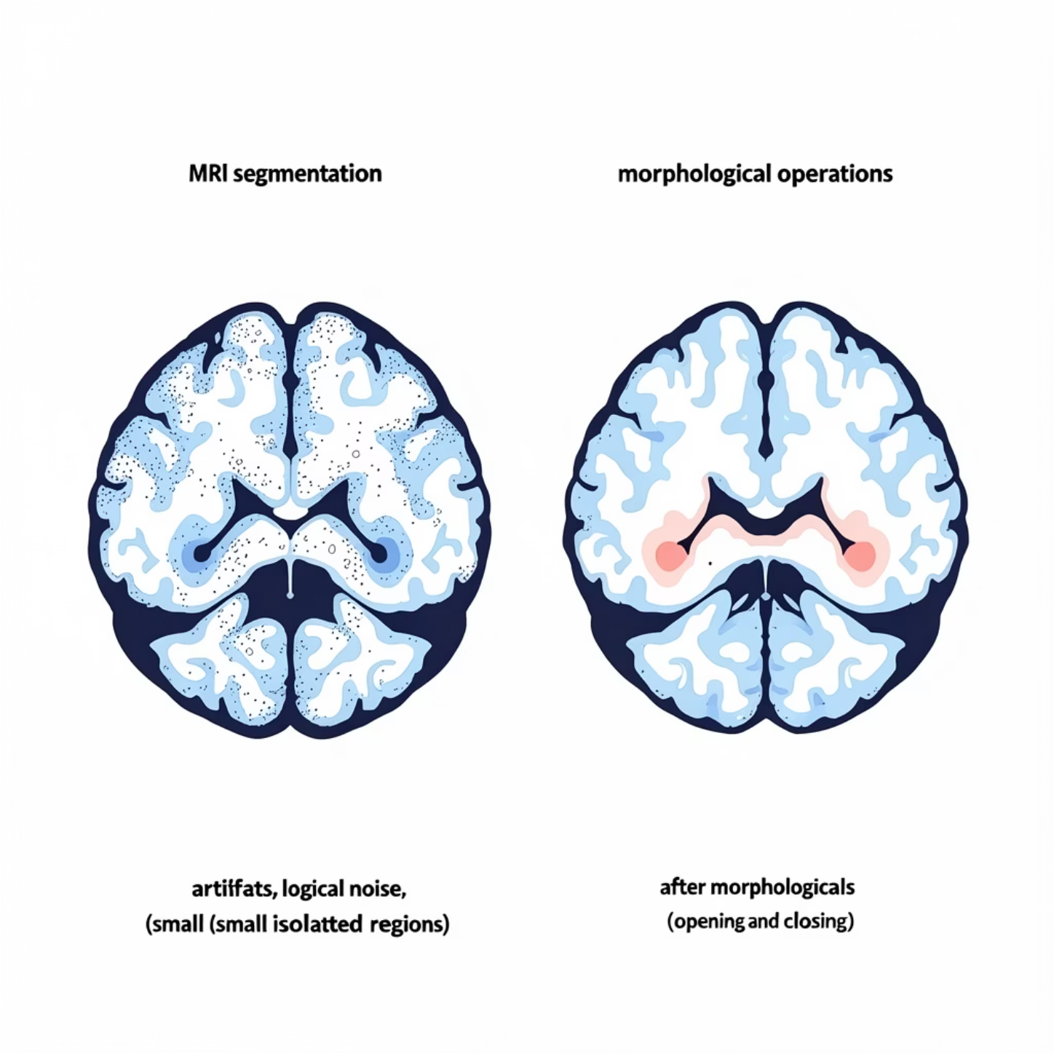

Morphological Post-Processing
Opening
Removes small isolated artifacts and noise using opening and area-based filtering.
Closing
Fills holes and connects fragmented regions through closing operations, improving spatial coherence.
Enhancement
Enhances segmentation quality without altering intensity-based thresholds or class definitions.

Slide 10
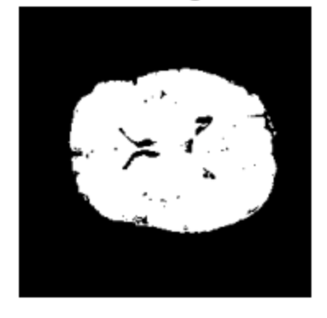
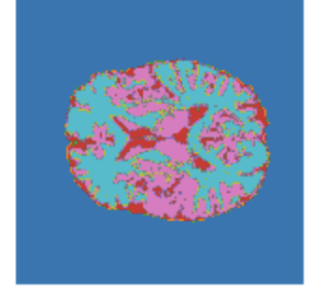
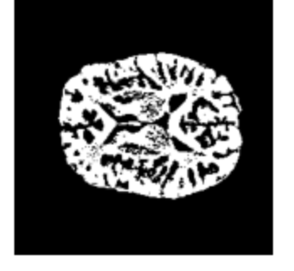
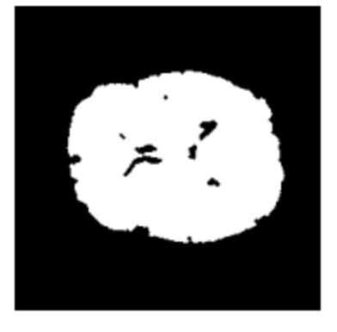
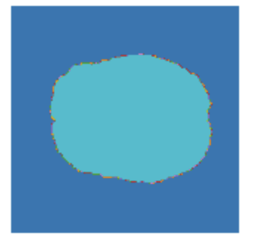
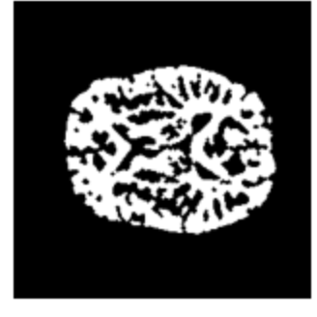
Post Processing: Techniques Comparisons
Before Post-Processing
Otsu Original
Multi-Otsu Original
Adaptive Original
After Post-Processing
Otsu Post Processed
Multi-Otsu Post Processed
Adaptive Post Processed

Slide 11
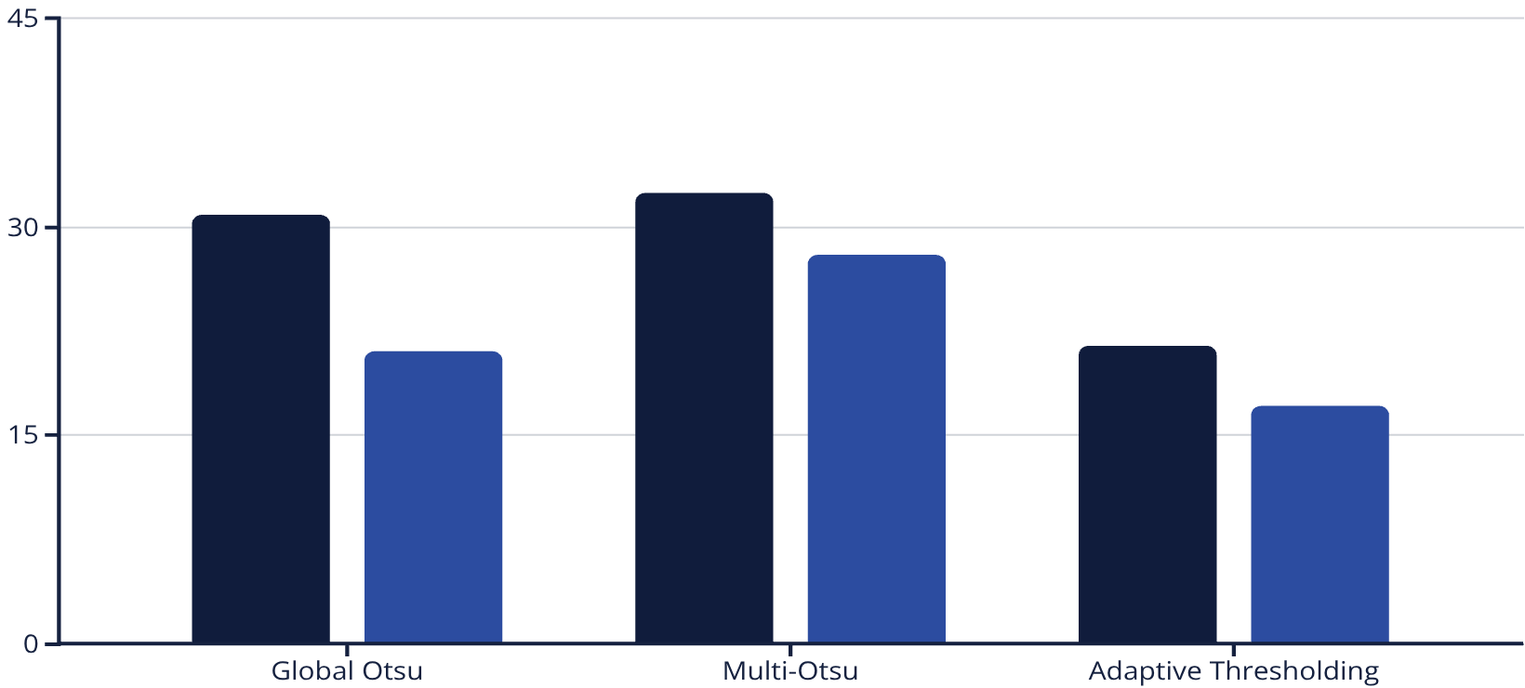
Thresholding Methods – Quantitative Comparison
Key Observations
Equalization reduces FG percentage across all methods
Multi-Otsu yields highest FG in original data
Adaptive thresholding shows lower FG detection
Cleaning has minimal impact on threshold values
Original FG %
Equalized FG %

Slide 12

Conclusion
Classical Techniques
1
Effective for brain MRI segmentation. Simplicity, interpretability, efficiency.
Limitations
2
Reduced ability for subtle variations compared to learning-based methods.
Value
3
Solid foundation for understanding image characteristics, preprocessing, and advanced methods.

